Slide 1



5,3 BILLION
Revenue for the Year 2019
MARKET INSIGHT
FOR E-COMMERCE COMPANY
Final Capstone Project by: Septy Windy
Delves into an extensive marketing and sales dataset from a prominent e-commerce company, aiming to extract actionable insights and strategic recommendations.

Slide 2

Project Overview
This project explores a comprehensive marketing and sales dataset from a leading E-Commerce company to derive actionable insights and recommendations.
Our objective is to analyze customer behavior, sales trends, and marketing performance, and to build predictive models for customer segmentation.
The analysis addresses questions such as revenue generation, customer acquisition/retention, discount and marketing effectiveness, and product performance

Slide 3

E-COMMERCE INFOGRAPHICS
Describe and Define Business Insights based on Revenue, Retention Rate, Sales KPI Analysis, Sales Trend Analysis, RFM Analysis and various other aspects
Exploratory analysis & market basket analysis to understand which of items can be bundled together with Apriori Algorithm.
Business Insight
Cross Selling Analysis
01
03
Describe and Define Business Insights based on Revenue, Retention Rate, Sales KPI Analysis, Sales Trend Analysis, RFM Analysis and various other aspects
Revenue Category Prediction
To understand how their behavior changes over time.
Cohort Analysis
02
04

Slide 4
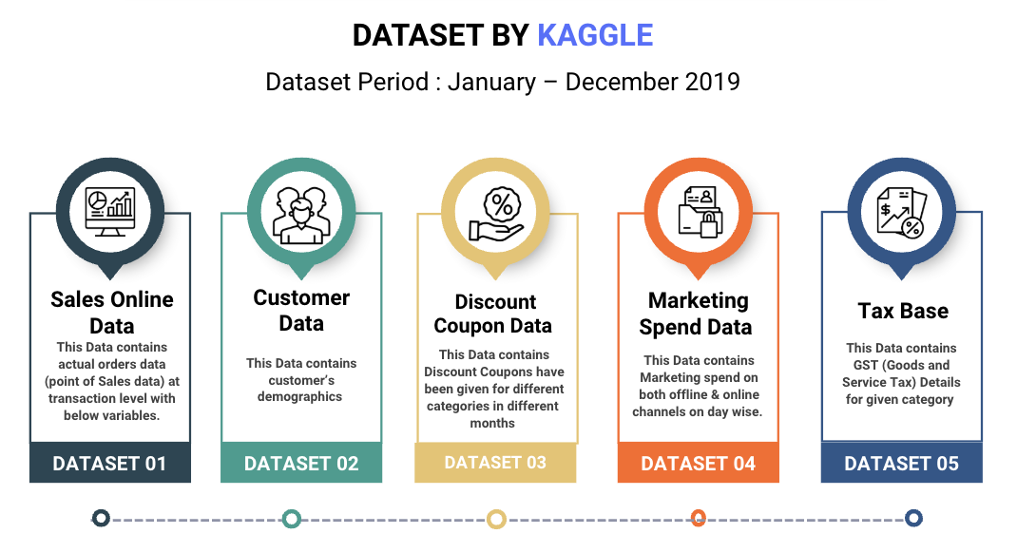
OUR STRATEGY

Slide 5






Business Insight Summary
$ 5,397,358.74
1,468
Customers
25,061 Transactions
238,033 Products
$ 310,772.46
$ 480,701.51
Invoice Value after Discount and Tax of each Transaction
Total Unique Customers Who Made Transactions
Total Invoice Count of Unique Transactions Created by Customers
Number of Sold Product
Total Discounted Sales
Total Tax Collected
REVENUE
CUSTOMER
TRANSACTION
QUANTITY
DISCOUNT
TAX

Slide 6

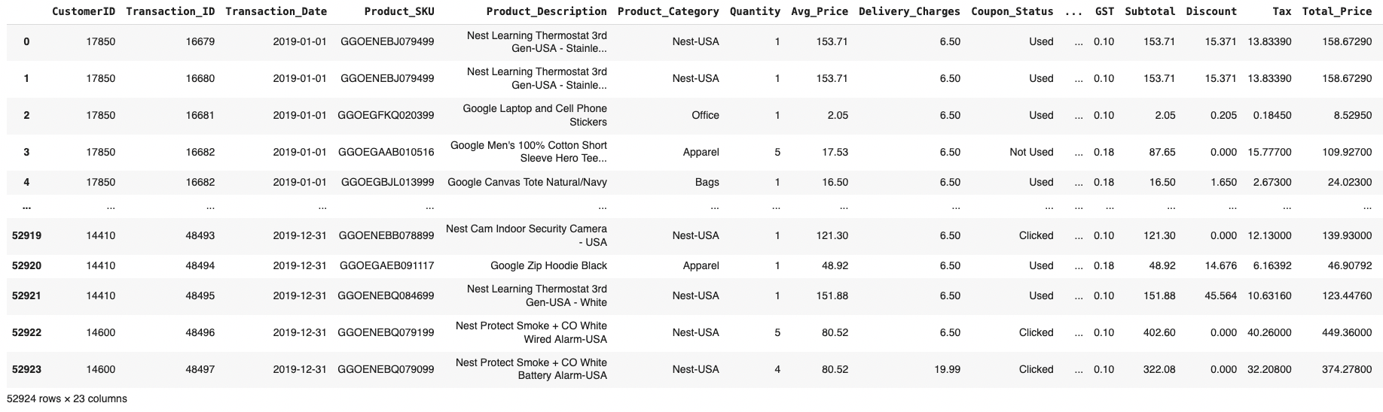

REVENUE ANALYSIS
REVENUE (INVOICE VALUE) ON EACH TRANSACTION IS OBTAINED FROM CALCULATION WITH THE FOLLOWING FORMULA:
SALES QUANTITY X AVERAGE PRICE X (1- DISCOUNT) X (1 + GST) + DELIVERY CHARGES

Slide 7
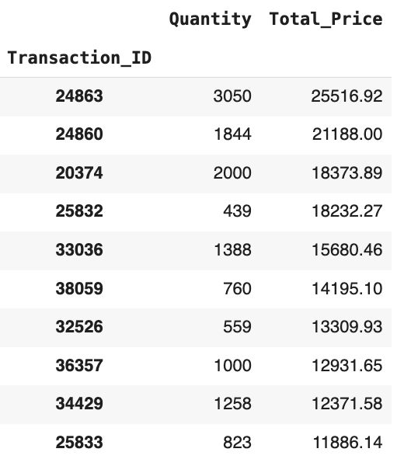
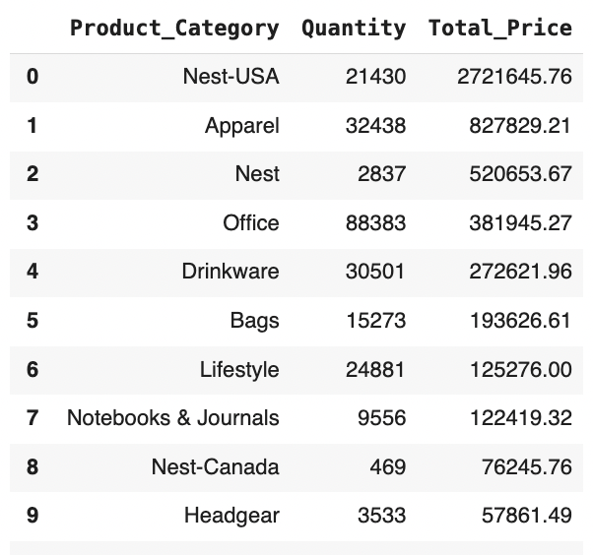
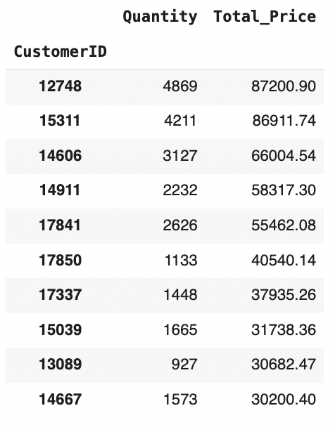

Revenue from Total Invoice Value is analyzed across each transaction, customer, and product category. When examining transactions in the e-commerce sector, the top three customers generating the highest revenue are those with IDs 12748, 15311, and 14606.
Additionally, the top three product categories contributing to revenue are Nest-USA, Apparel, and Nest. Finally, the top three transaction IDs with the highest revenue are 24863, 24860, and 20374.

Slide 8
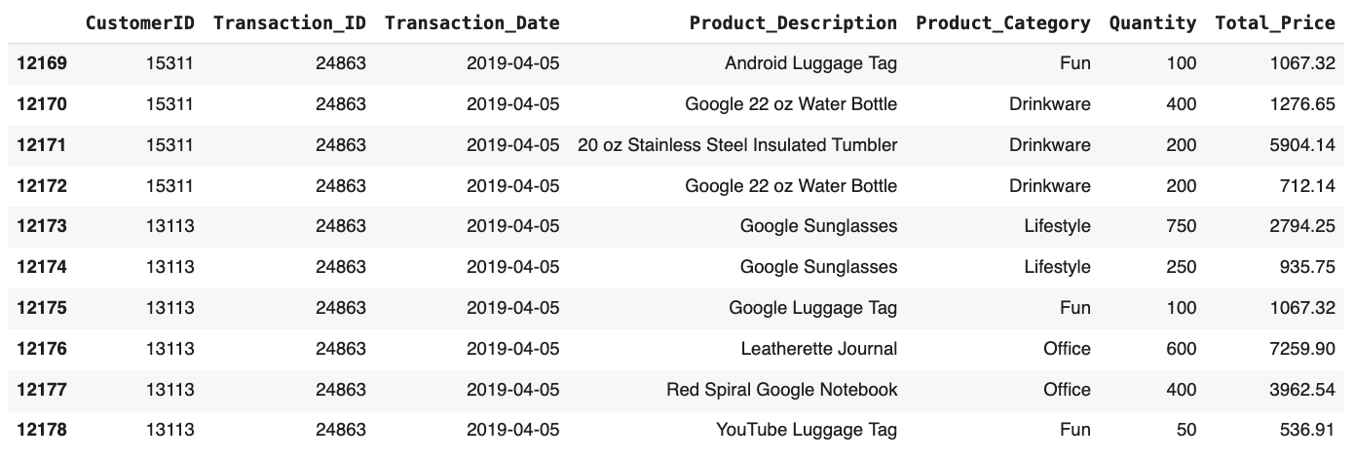
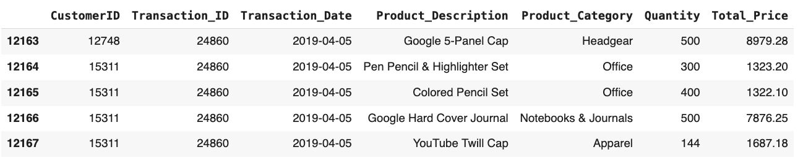
The revenue from Transaction IDs 24863 and 24860 is attributed to customers with IDs 15311 and 12748. Notably, both of these customers rank among the top three contributors to overall revenue.

Slide 9
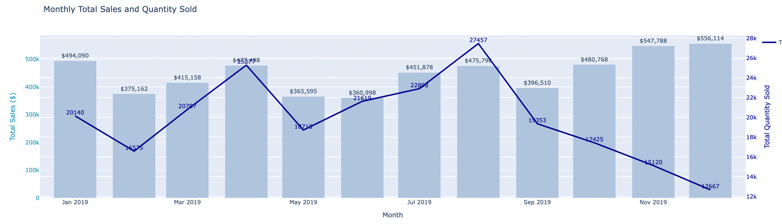
TOTAL SALES AND QUANTITY SOLD
For The Year 2019
In December, we achieved our highest sales figure of $556,114.06, although it coincided with the lowest number of orders for the year, totaling just 12,667 units. This phenomenon can be attributed to the strong contributions from Nest and Nest USA, which accounted for 78.02% of sales in December.
The prices for Nest and Nest USA products range between $100 and $250. Additionally, sales in the security category surged during the last quarter of 2019, driven by a combination of factors, including heightened consumer concerns about holiday security, budget cycles, and year-end promotions.

Slide 10
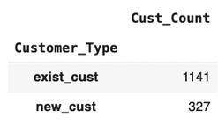
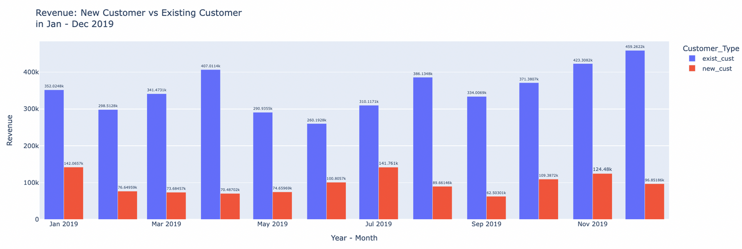
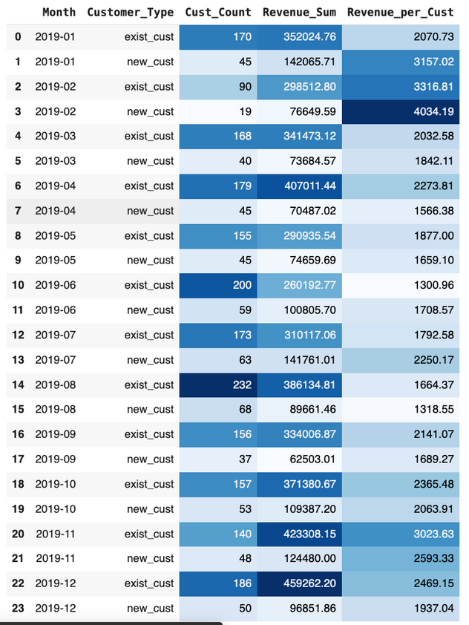
Revenue Analysis: Existing Customers vs. New Customers
In total, 327 new customers were acquired during the 2019 period. The highest influx of new customers occurred in August, with 68 new customers, while the lowest was in February, with only 19 new customers. (Note: A customer is classified as new if their tenure is less than or equal to 12 months.)
During the same period, we recorded 1,141 existing customers. The revenue contributions were as follows:
The highest revenue from Existing Customers was in December, totaling $435,165.30.
Conversely, the peak revenue from New Customers occurred in January, amounting to $140,038.90.
When analyzing Revenue Per Customer (revenue_per_cust), February 2023 stands out, as it recorded the highest revenue per New Customer at $3,909.93.
This data underscores the significant contributions of both existing and new customers to our overall revenue.

Slide 11
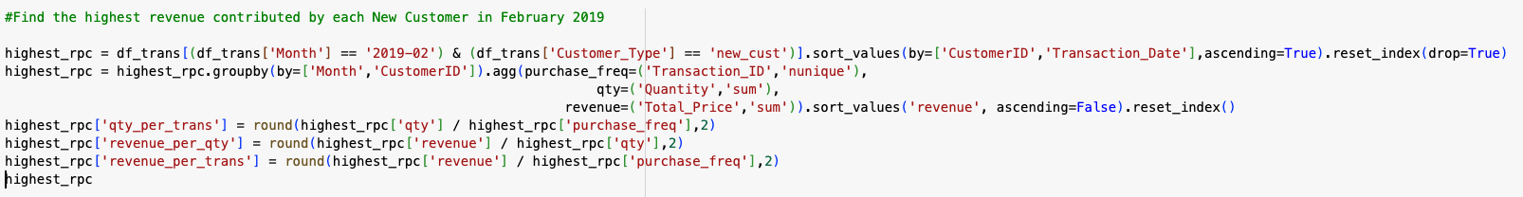
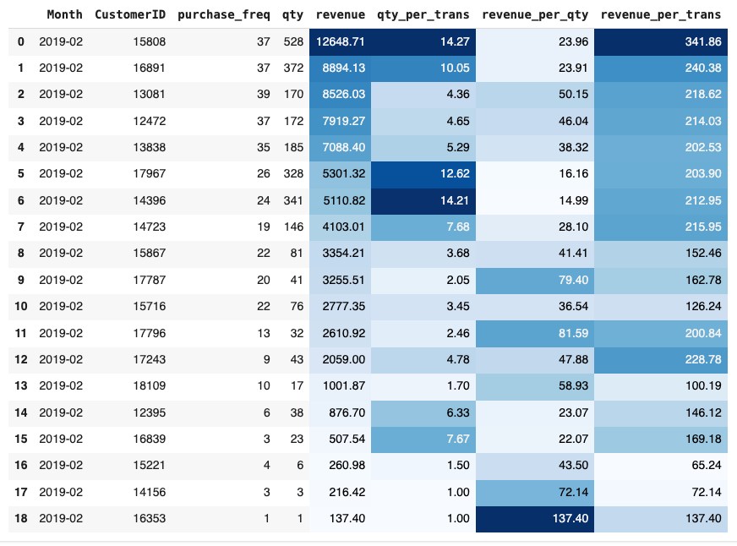
New Customer Revenue Detail (February 2019)
In February 2019, the highest Revenue per Customer was recorded with 19 customers. Notably, Customer ID 15808 made the most significant contribution, generating $12,454.89 from a total of 37 transactions.
Additionally, the highest Revenue per Quantity was attributed to Customer ID 16353, who spent $137.40 on products. Meanwhile, Customer ID 15808 also led in Revenue per Transaction, with an amount of $336.62.
This analysis highlights key customers and their substantial impact on revenue during the month.

Slide 12
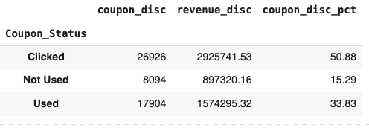
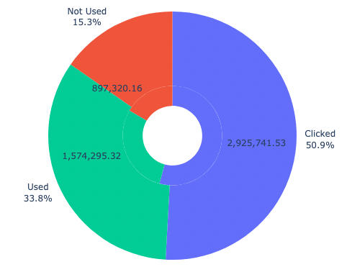
The Role of Discounts in Revenue Generation
When examining the percentage of the total customer base, it appears that the utilization of discounts was not fully optimized during the 2019 period. Although 84.07% of customers had the opportunity to use discounts when making transactions, only 33.08% actually took advantage of them, so the coupon likely helped secure the purchase. Good for measuring ROI of campaigns.
Additionally, 50.90% of customers clicked on discount offers but did not utilize them (Coupon Status = Clicked). This represents a significant opportunity to engage and persuade these customers to convert their interest into actual discount usage, thereby enhancing their overall engagement.
Analysis of Discount Utilization Among Customers in 2019

Slide 13
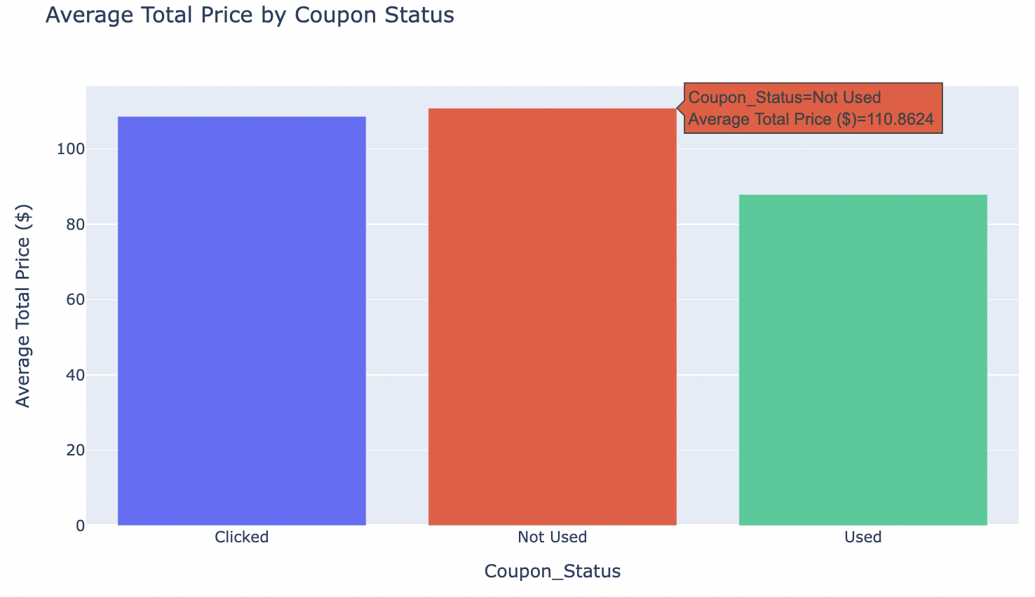
The Role of Discounts in Revenue Generation
Customers Who ‘Not Use’ Coupons Is Spend the Most
At $110.86 revenue for ‘Not Use’, it indicates that the customers or those who purchase without the influence of a discount. These customers are likely buying based on need, brand loyalty, or perceived value, rather than price sensitivity.
2. ‘Use Coupon’ Leads to a Lower Average Sale Amount
At $87.93 ‘Use Coupons’ attract price-sensitive customers who may be looking for a deal and are less likely to purchase high items or add extra items to their cart.
3. ‘Clicked’ Customers Show High Purchase Intent and Value
It representing customers who engaged with a coupon but didn't use it, has a very high average sales amount of $108.66. And it suggests that the act of *considering* a coupon does not necessarily mean the customer is price-sensitive.

Slide 14
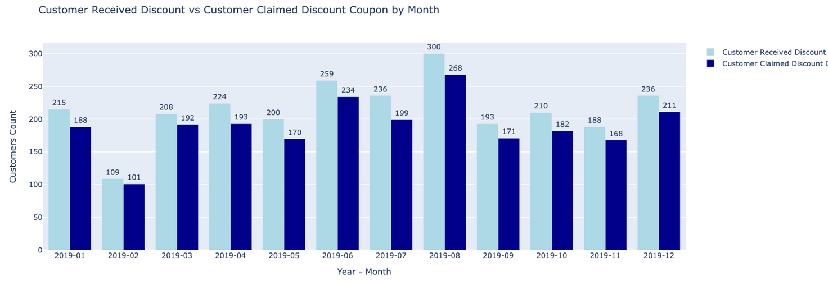
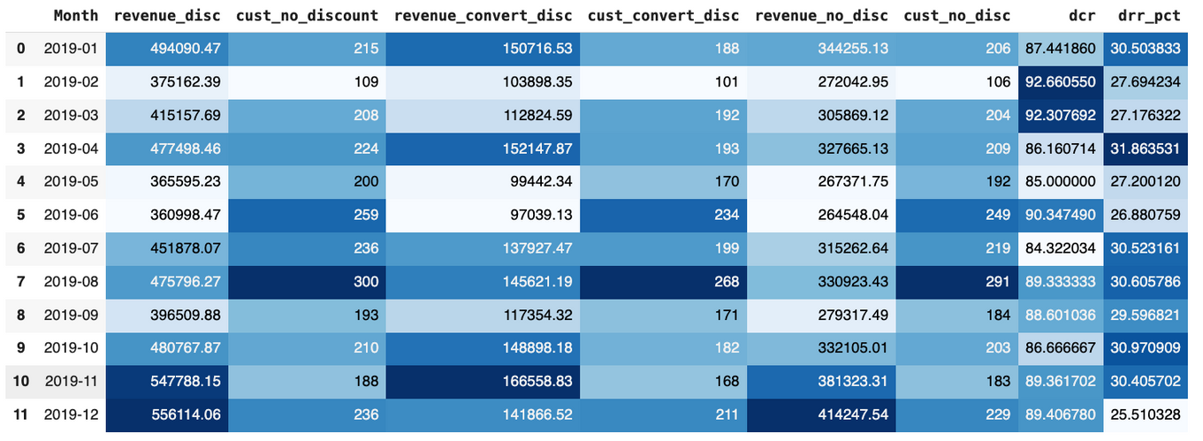
Analysis of Discount Utilization Among Customers in 2019
In August, we witnessed the highest number of customers taking advantage of discounts, totaling 300 customers. Out of these, 268 customers successfully claimed their discounts to complete transactions. This indicates a strong interest in discount offers during this month, reflecting effective promotional strategies.
When we look at the Discount Conversion Rate (DCR), February emerges as a standout month, achieving an impressive rate of 92.66%. This means that 101 out of 109 customers who were eligible to claim discounts actually did so. Such a high conversion rate suggests that customers in February were not only aware of the discounts but were also motivated to utilize them, highlighting the effectiveness of the promotional campaigns during that time.
Overall, these insights reveal that while August had the highest number of customers engaging with discounts, February showcased a superior ability to convert potential interest into actual transactions.

Slide 15
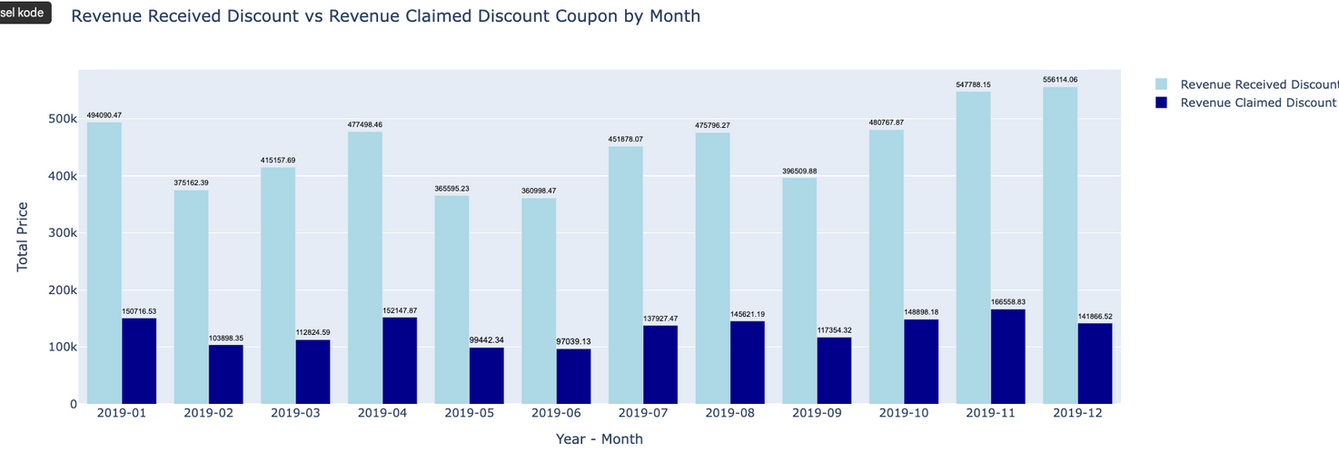
Revenue Insights from Discounted Purchases
In November, we observed the highest revenue generated from customers who converted to discounted purchases, amounting to $166,558.83. This impressive figure represented 30.41% of the total revenue for the month, indicating that discounts played a significant role in driving sales during this period. The effectiveness of discount strategies in November suggests that seasonal promotions and marketing efforts likely resonated well with customers, encouraging them to take advantage of these offers.
Conversely, when analyzing the Discount Revenue Rate (DRR), April emerged as the month with the highest rate, contributing $152,147.87 to total revenue. This contribution accounted for 31.86% of April's overall revenue, reflecting a strong engagement from customers during this time.
The juxtaposition of these months illustrates the varying impacts of discount strategies throughout the year. While November generated substantial revenue, April demonstrated the highest conversion efficiency through discounts.

Slide 16
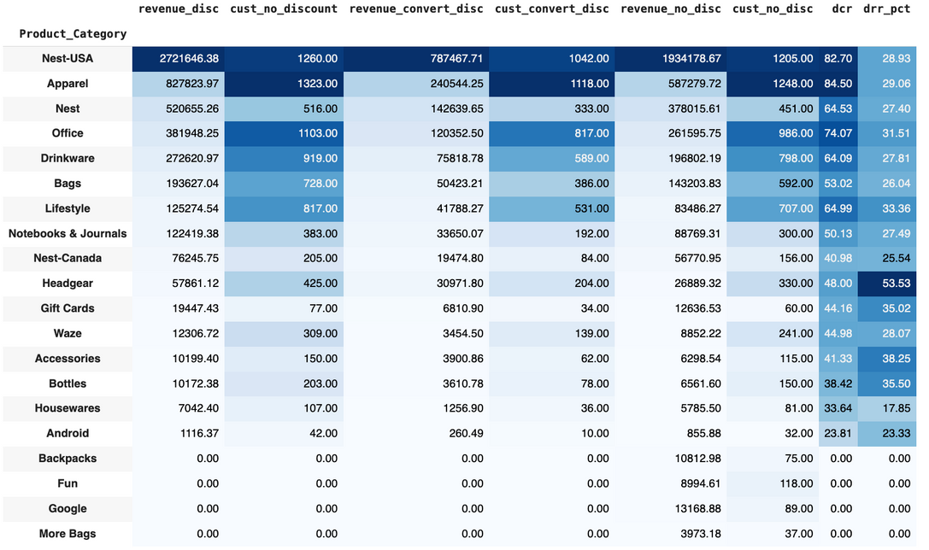
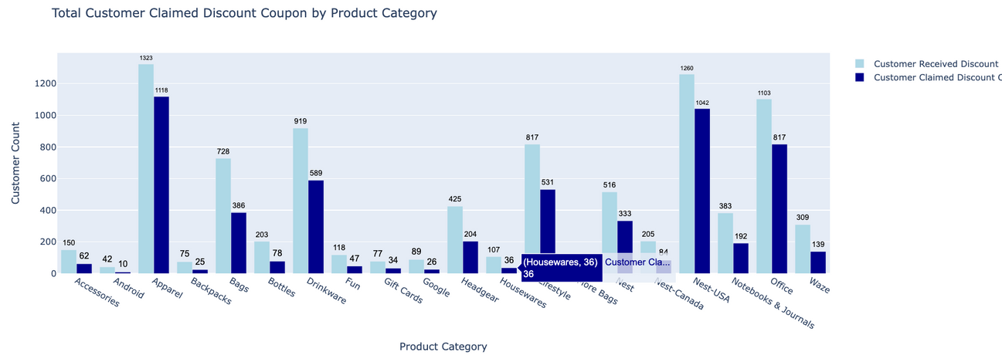
Customer Insights by Product Category
When examining the number of customers receiving discounts by product category, Apparel Products stand out as the most popular choice. A total of 1,323 customers received discounts on apparel, with 1,118 customers successfully claiming these discounts to complete their transactions.
In terms of the Discount Conversion Rate (DCR), Apparel Products also lead, achieving an impressive rate of 84.5%. This means that 1,118 out of 1,323 customers who purchased apparel actively utilized their discounts.
These figures highlight the strong appeal of apparel discounts and the effectiveness of promotional strategies in converting interest into actual purchases.

Slide 17
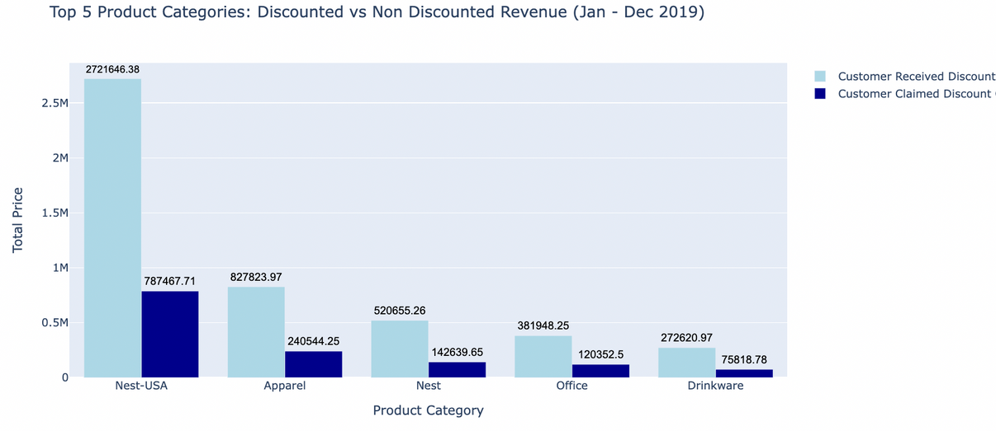
Customer Insights by Product Category
When analyzing customer conversions based on product categories, the Nest-USA Product generated the highest revenue from discounted purchases, totaling $787,467.71. This impressive figure accounts for 29.93% of the total revenue for the Nest-USA Product line, as reflected in the Discount Revenue Rate (DRR).
In terms of the DRR, the Headgear Product category achieved the highest rate, contributing $30,971.80, which represents 53.53% of the total revenue for Headgear.
These insights illustrate the effectiveness of discount strategies across different product categories, highlighting areas of strong customer engagement and revenue generation.

Slide 18
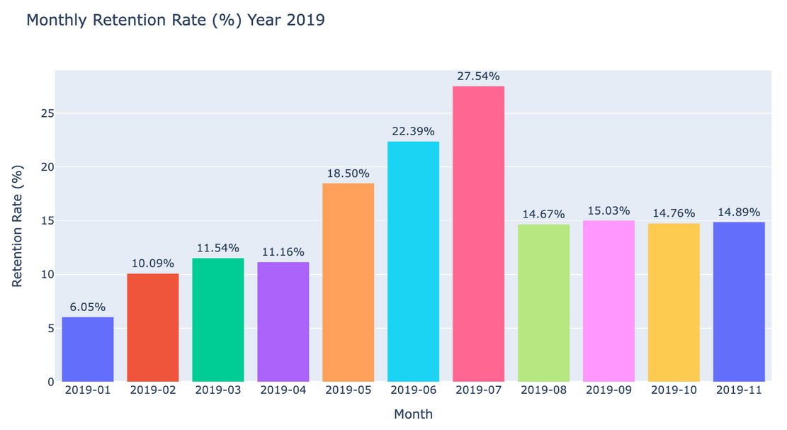
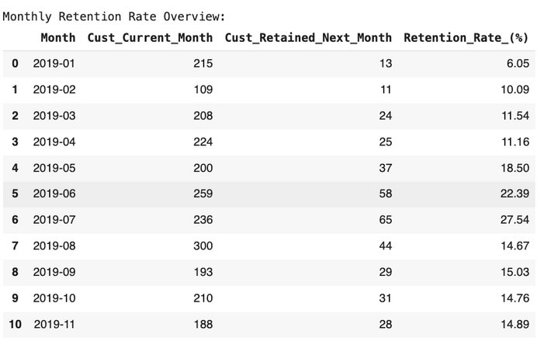
Retention Rate (%) Analysis
The lowest retention rate was recorded in February 2019, with a mere 6.05%. In contrast, the highest retention rate was achieved in August 2019, showcasing a much more favorable figure of 27.54%.
These fluctuations underscore the varying levels of customer engagement throughout these months, offering valuable insights for refining future retention strategies.

Slide 19
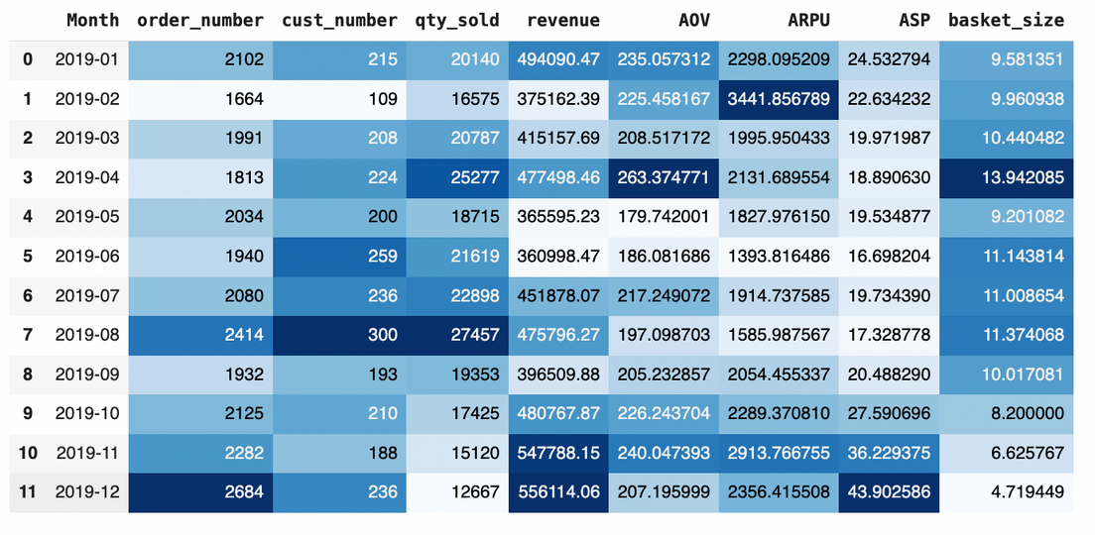
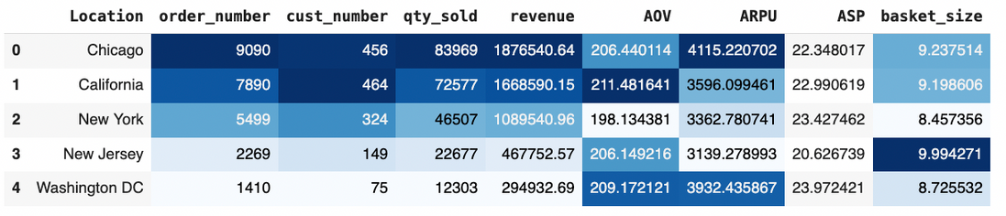
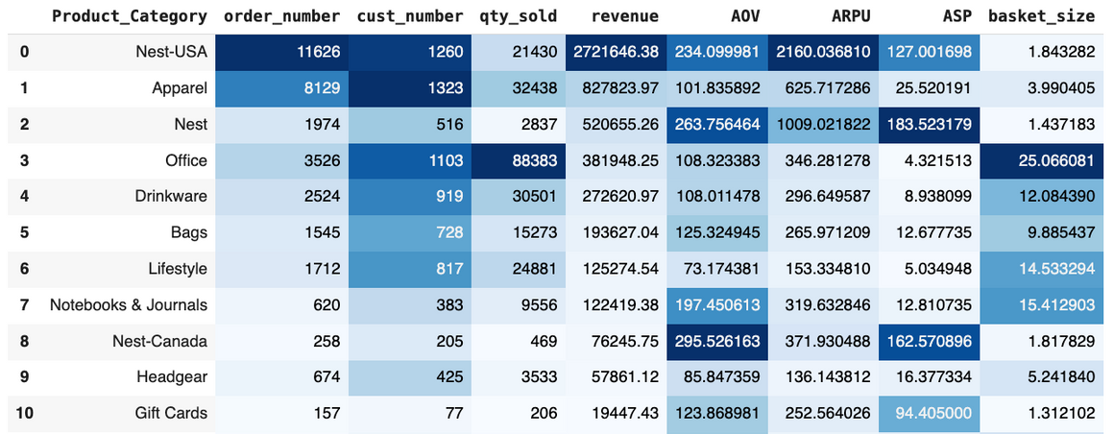
Sales KPI Analysis
Key Performance Indicators (KPIs) used include: Average Order Value (AOV), Average Revenue per User (ARPU), Average Selling Price (ASP) and Basket Size.
AOV is used to see the Average Contribution to Revenue for each Transaction (Order) and ARPU to see the Average Contribution to Revenue for each Customer (User).
In addition, ASP is used to refer to the average selling price of a product or service in a certain period of time.
Basket Size is used to see how much the Average Number of Products purchased by a Customer in each Transaction they make.

Slide 20
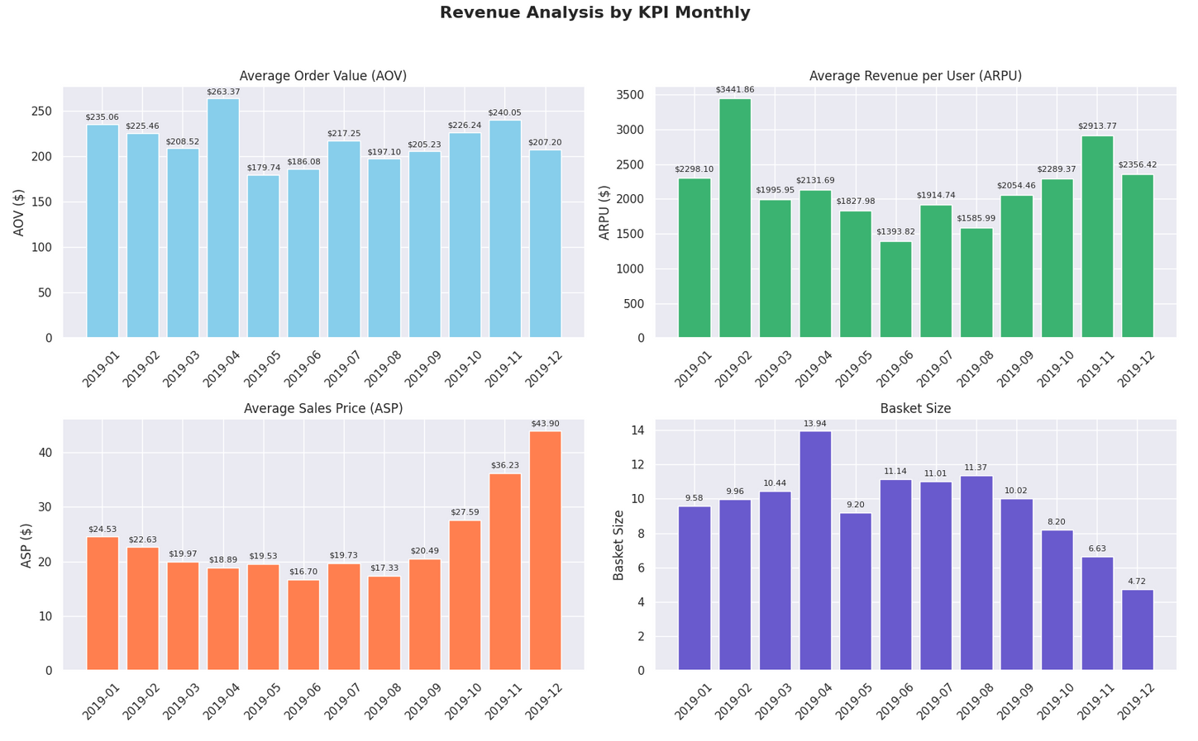
Sales KPI Analysis
Average Order Value (AOV)
The highest Average Order Value (AOV) was recorded in April, reaching $263.37, despite having the second-lowest number of transactions in 2019. This month saw a substantial quantity of products purchased, totaling 25,277 items, with an impressive Basket Size of 13.94 products. Notably, April's product quantity ranks as the second highest in 2019, while its Basket Size is the highest for the year.
Average Revenue per User (ARPU)
In terms of Average Revenue per User (ARPU), February stood out with a peak of $3,441.86, indicating that each customer contributed an average revenue of $3,441.86.
Average Selling Price (ASP)
The Average Selling Price (ASP) reached its highest point in December, at $43.90, meaning that each product sold in December generated an average revenue of $43.90.
Basket Size
April also recorded the highest Basket Size, averaging 13.94 products per transaction. This suggests that customers typically purchased between 13 and 14 products in each order.

Slide 21
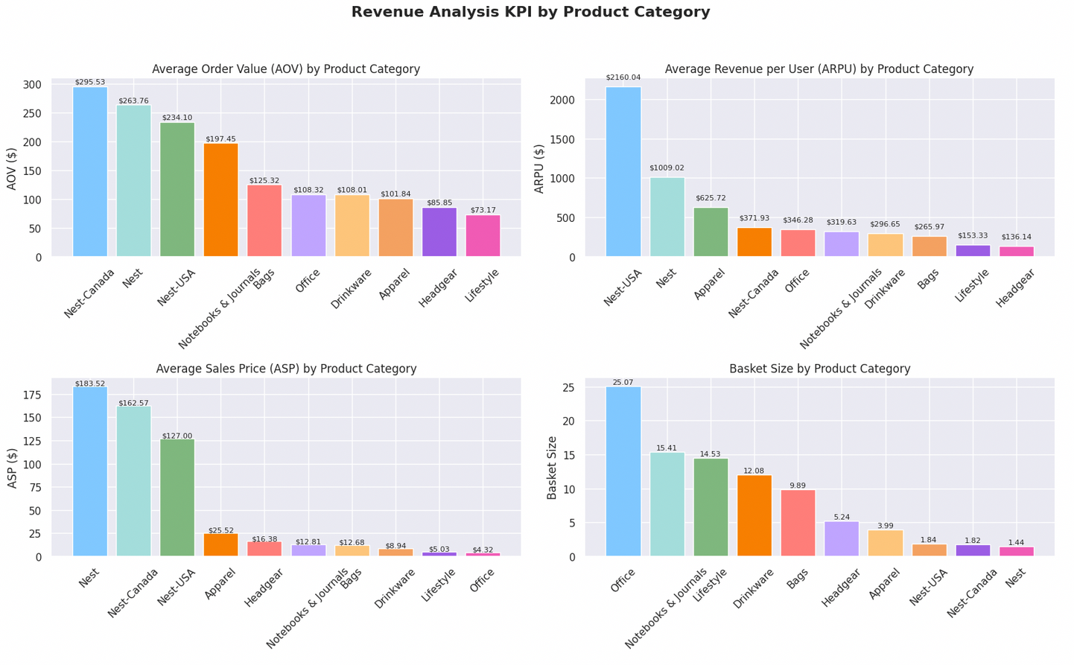
Sales KPI Analysis
Revenue Sales KPI by Product Category
Average Order Value (AOV)
The highest Average Order Value (AOV) was recorded in Nest-Canada, reaching $295.53. This indicates that each transaction contributed an average revenue of $295.53.
Average Revenue per User (ARPU)
In terms of Average Revenue per User (ARPU), Nest-USA achieved the highest figure at $2,160.04, meaning that each customer contributed an average revenue of $2,160.04.
Average Selling Price (ASP)
The Average Selling Price (ASP) reached its peak in Nest, at $183.52. This indicates that each product sold in this category generated an average revenue of $183.52.
Basket Size
The highest Basket Size was noted in the Office category, with an average of 25.07 products per transaction. This suggests that each customer typically purchased approximately 25 products in each order.

Slide 22
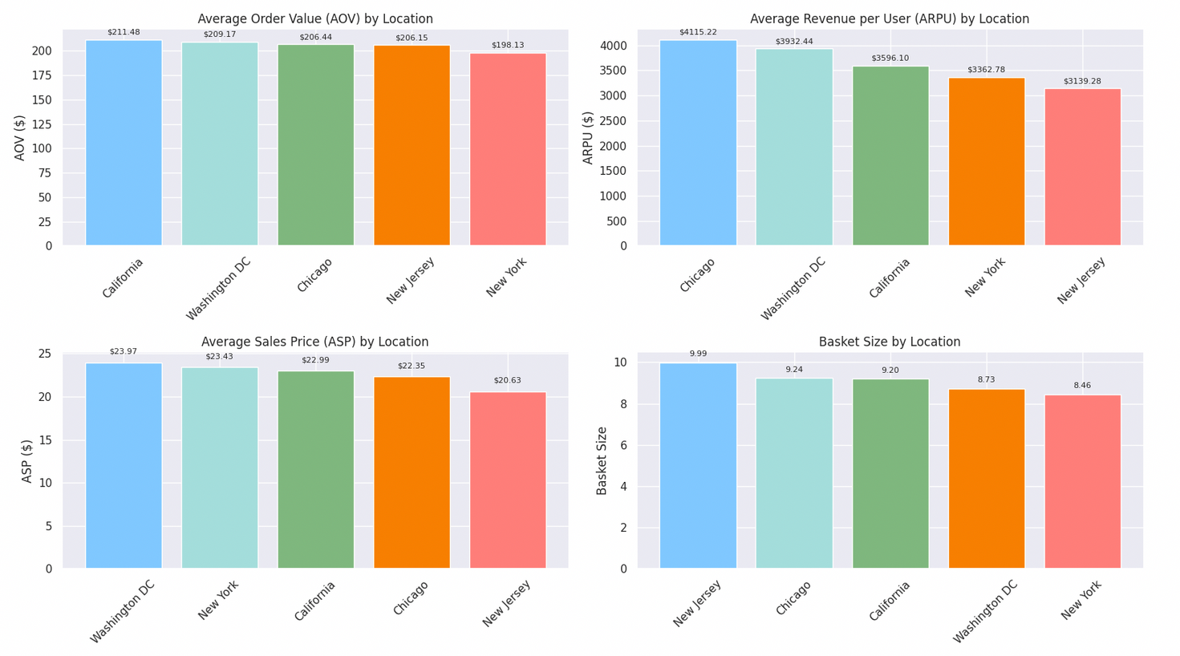
Sales KPI Analysis
Revenue Sales KPI by Location
Average Order Value (AOV)
The highest Average Order Value (AOV) was recorded in California, at $211.48. This indicates that each transaction contributed an average revenue of $211.48.
Average Revenue per User (ARPU)
In terms of Average Revenue per User (ARPU), Chicago achieved the highest figure at $4,115.22, meaning that each customer contributed an average revenue of $4,115.22.
Average Selling Price (ASP)
The Average Selling Price (ASP) peaked in Washington DC, at $23.97. This signifies that each product sold in this area generated an average revenue of $23.97.
Basket Size
The highest Basket Size was observed in New Jersey, with an average of 9.99 products per transaction. This suggests that each customer typically purchased approximately 9 to 10 products in each order.

Slide 23
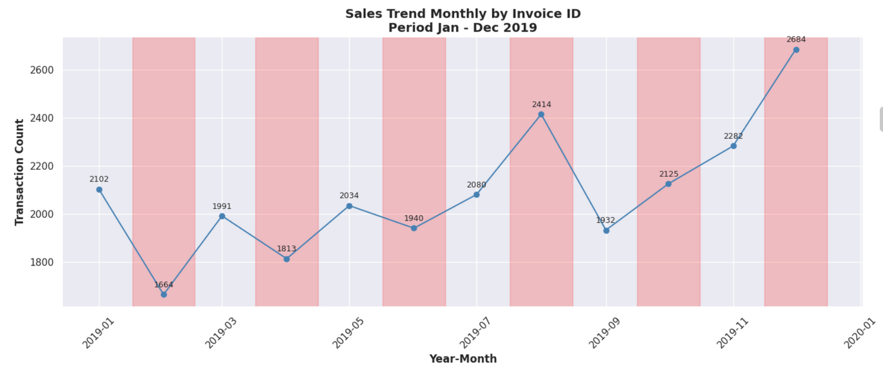
Sales Trend Analysis
Quarterly Invoice Count Sales Trend Analysis(2019)
Initial Growth: The year commenced with a transaction count of 2,102 in January, reflecting a steady initial growth. However, the following month marked a decline, resulting in the lowest sales of the year.
Mid-Year Fluctuations: There was a noticeable decline in April (1,813) and June (1,940), indicating a dip in sales during the mid-year period. This could be attributed to seasonal variations or external market factors.
Recovery Phase: As the year progressed, sales began to recover in July, reaching 2,080. This upward trend continued through the latter half of the year, with transaction counts fluctuating but remaining above the earlier months.
Year-End Surge: By October, transaction counts climbed to 2,125, culminating in a significant increase to 2,684 in December. This surge could be linked to holiday shopping and promotional activities typical of the end-of-year period.

Slide 24
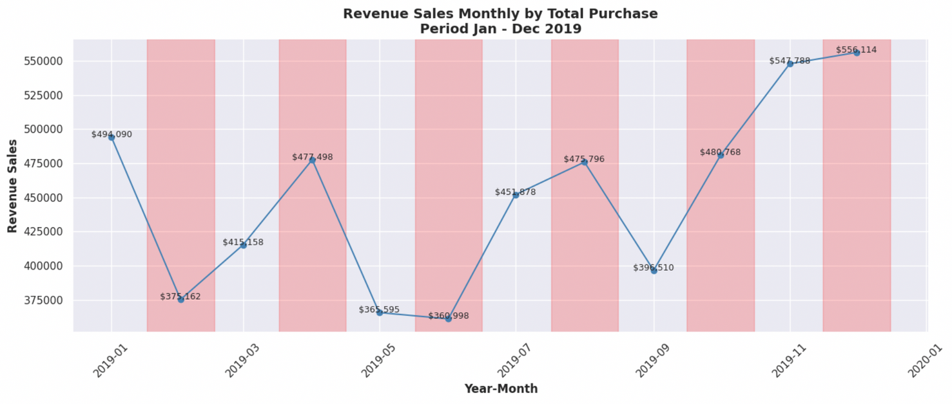
Sales Trend Analysis
Quarterly Revenue Trend Analysis (2019)
Initial Growth: The year began with strong sales in January at $494,090, followed by significant drop to $375,162 in February. Sales then entered a recovery phase in March and April 2019
Mid-Year Fluctuations: A sharp decline occurred in the middle of the year, with revenue falling to $365,595 in May and hitting the lowest point of the year in June at $360,998.
Recovery Phase: Following this trough, a strong rebound was observed in July with sales reaching $451,878, and this upward trend continued into August with revenues of $475,796.
Year-End Surge: A dip in Sales was registered in September at $396,510 before embarking on period of substantial growth in October for $480,768. and continue to surge in November by reaching sales $547,788. And the Year concluded with the highest monthly sales figure in December at $556,114
In summary, the sales revenue in 2019 was characterized by significant volatility with several peaks and troughs. Despite a mid-year slump, the year ended on a very strong note, with the last quarter showing the most significant and sustained growth, culminating in the year's highest revenue in December.

Slide 25
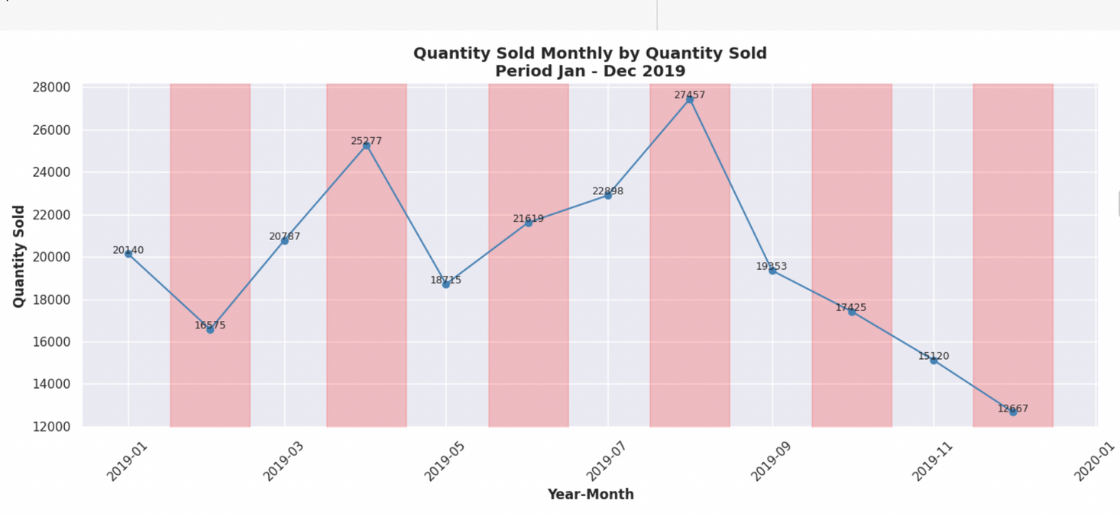
Sales Trend Analysis
Quantity Sold Trend Analysis (2019)
Extreme Fluctuations: The year was marked by significant volatility, with the quantity sold experiencing dramatic peaks and troughs. Sales volume ranged from a high of 27,457 units in August to a low of 12,667 units in December, showcasing a wide and unpredictable variance in monthly performance.
Major Peaks Followed by Sharp Drops: The data reveals two prominent spikes in sales. The first occurred in April when sales reached 25,277 units, followed by a sharp decline to 18,715 units in May. A second, even higher peak was reached in August with 27,457 units sold, which was immediately followed by a steep downturn.
Mid-Year Surge: After a slump in May, the quantity sold showed a strong recovery, increasing from 18,715 units to 21,619 in June, 22,898 in July, and ultimately reaching the year's highest point in August. This mid-year period represented the strongest growth phase of the year.
Sustained Decline in the Final Quarter: The most significant trend in the latter part of the year was a consistent and sharp decline in sales from the August peak. The quantity sold fell progressively through September (19,353), October (17,425), November (15,120), and hit the year's lowest point in December (12,667), indicating a very weak end to the year.

Slide 26
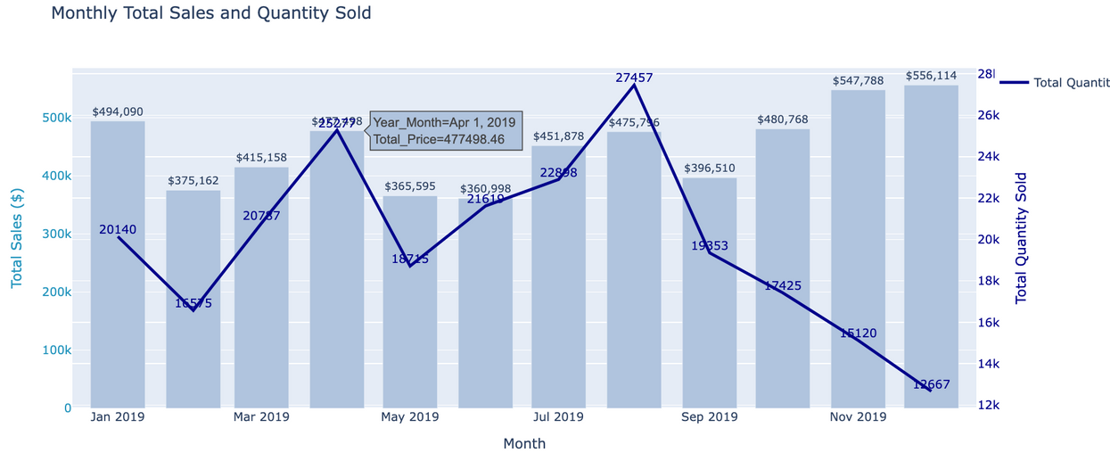
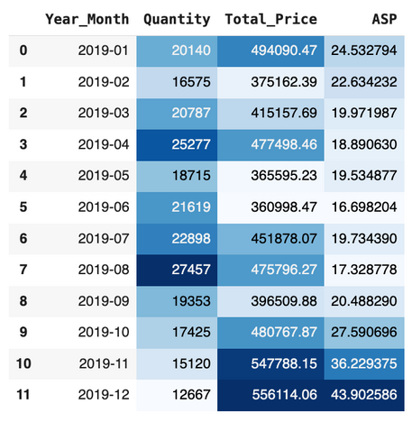
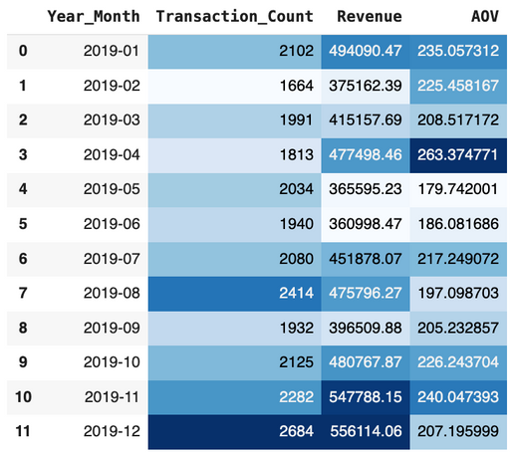
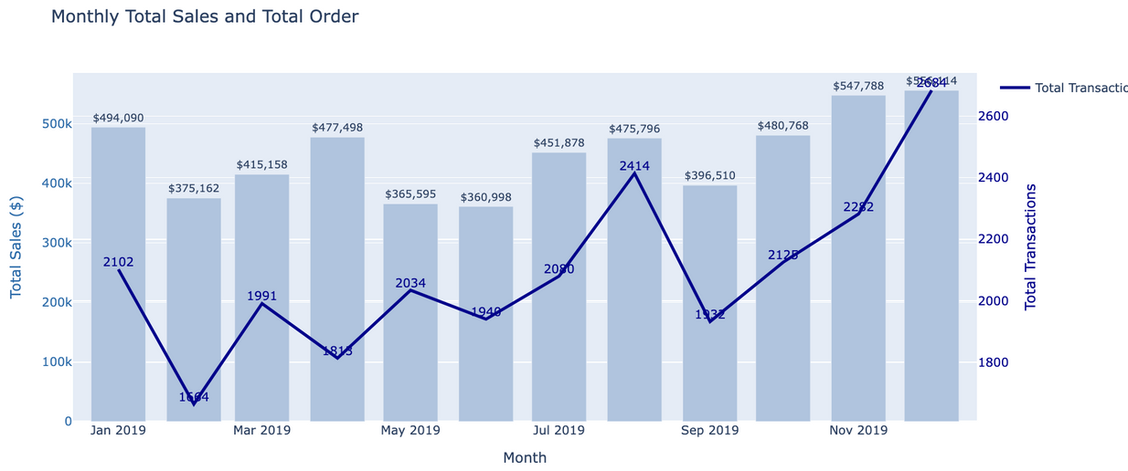
Sales Trend And Revenue Analysis
An intriguing observation from the two visualizations is the contrasting trends they reveal. The top left visualization indicates a continuous decline in the quantity of products purchased from October to December. In contrast, the bottom left visualization shows a steady increase in the number of transactions during the same period.
This discrepancy suggests that while the number of transactions rose, the products being purchased had a relatively high Average Selling Price (ASP) per unit.
These insights highlight that customers in those months were purchasing goods at a higher ASP, which is further supported by revenue figures from October to December, placing them among the top three highest revenue months.

Slide 27
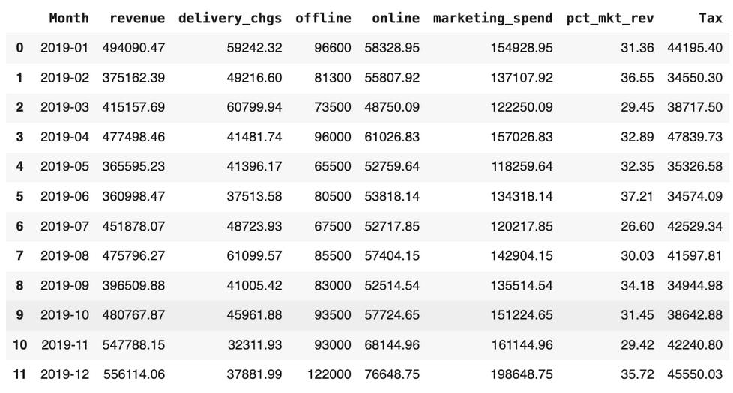
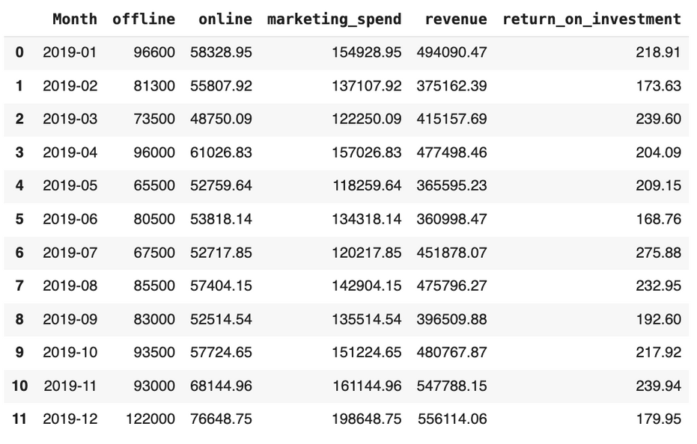
Marketing Spend Analysis
A Comprehensive Review of Expenditures
This analysis examines the relationship between marketing expenditures and revenue, focusing on the percentage of marketing spend relative to revenue and the return on investment (ROI).
Observing the data presented on the left, June stands out with the highest percentage of marketing spend to revenue, reaching 37.21%. Interestingly, June also ranks among the top four months for the lowest marketing spend. The notable increase in revenue during this month can be attributed to the lowest tax costs of 2019, which is a key component in revenue calculation.
Additionally, July recorded the highest ROI, soaring to approximately 275.88%.

Slide 28
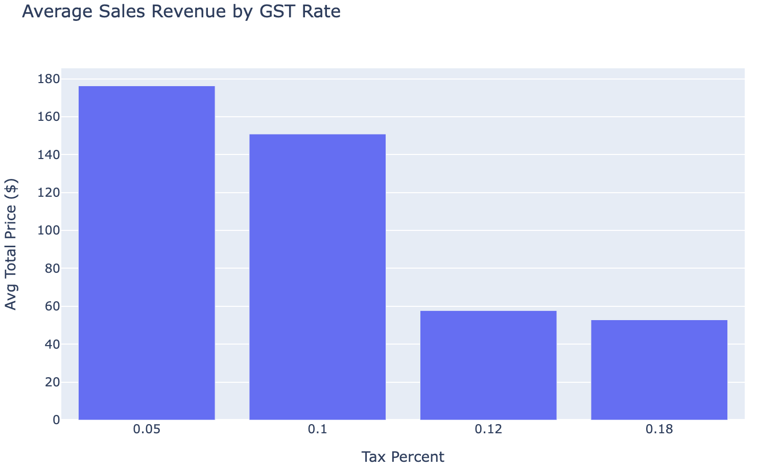
Tax Impact Analysis
Lower Tax Rates Drive Higher-Value Purchases
The two lowest tax brackets, 5% and 10% are associated with the highest average sale amounts by a large margin. With average value at $176.25 and $150.85. This suggests that customers are willing to make much larger purchases when the tax burden is lower.
Clear Divergence in Spending at the 12% and 18% GST Rate
The average sale amount plummets from $150.85 to just $57.72. This is a decrease of over 61% suggests that 12% tax rate may be a psychological barrier for customers, significantly discouraging larger purchases.
3. Higher Tax Rates are Linked to Low-Value Transactions
The average sale amount at 12% tax is $57.72, and it decreases slightly to $52.83 at the 18% tax rate. This indicates that once the tax rate crosses a certain threshold, customers predominantly make smaller, potentially essential-only purchases, and are highly resistant to spending more.

Slide 29


E-Commerce Company
Customer Segmentation
(by RFM and K-Means)
THE COMPETITOR IN MARKETPLACE SECTORS
“A small percentage of your customers likely drive a large portion of your revenue and profit.” - Pareto Principle (or 80/20 rule)

Slide 30
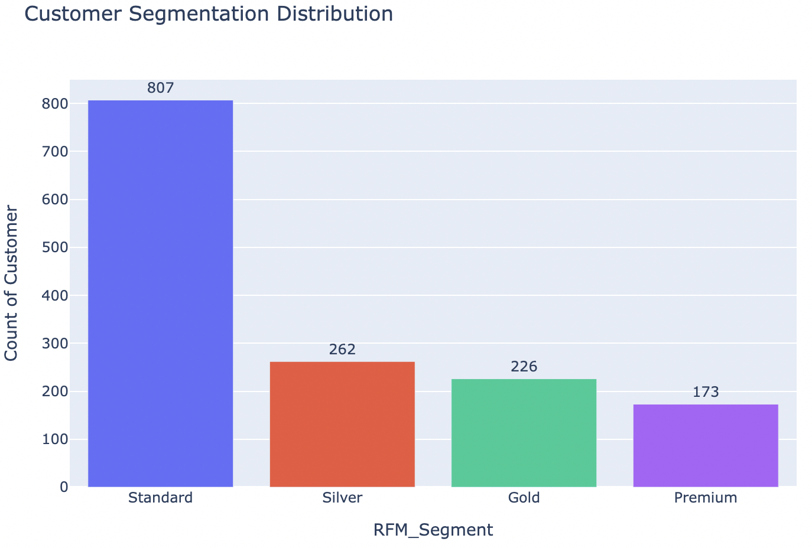
Customer Segmentation (RFM Analysis)
The Vast Majority of 'Standard' Customer with 807 customers is more than all other segments combined. These might be new customers who have only made one purchase or customers who have not bought anything in a long time.
The most valuable segments, ‘Gold' (226 Customers) and 'Premium' (173 customers) are the smallest, but they are loyal and highest-spending customers. This reinforces the Pareto Principle (or 80/20 rule), “suggesting that a small percentage of your customers likely drive a large portion of your revenue and profit.”
Mid-Tier Customers on 'Silver' with 262 customers, that could be customers are more engaged than the 'Standard' group but have not yet reached the high value of the 'Gold' or 'Premium' segments.

Slide 31
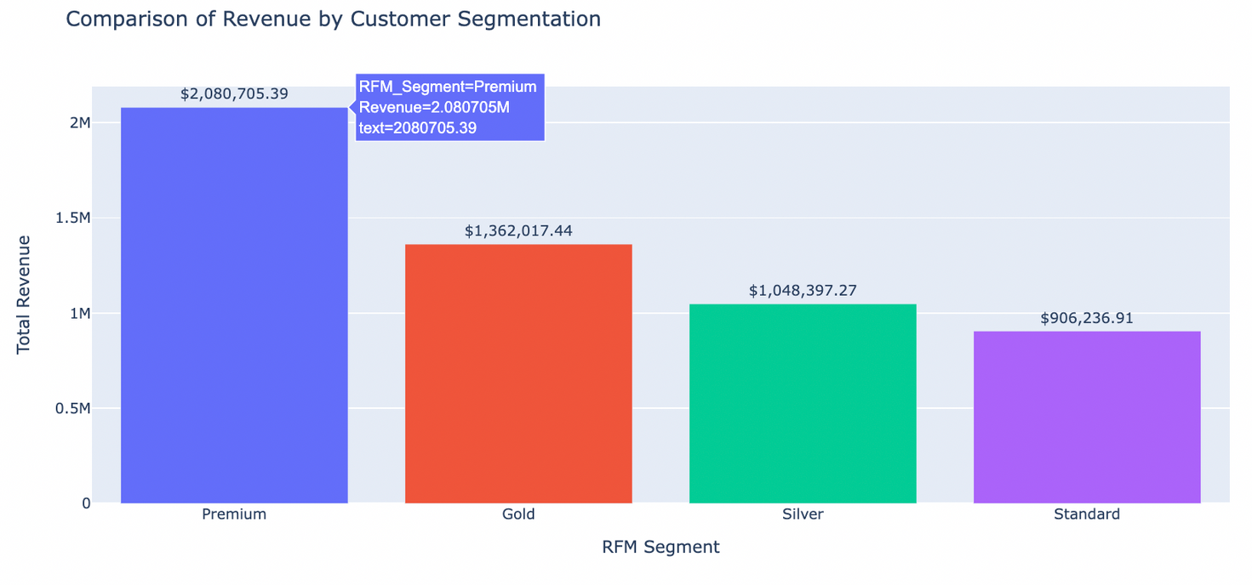
Customer Segmentation (RFM Analysis)
"Although Premium Customers make up only 11% of the customer base, they contribute 40% of total revenue — making them extremely valuable."
The 'Premium Customer' is the single largest source of revenue, bringing in USD 2,080,705.39. And the 'Gold Customer' is the second-largest revenue driver at USD 1,362,017.44. Together, the top two tiers ('Premium' and 'Gold') account for over $3.4 million in revenue.
The 'Standard Customer' High in Numbers, Low in Impact.
By customer count (807 customers), contributes the least amount of revenue, at $906,236.91. This 'Standard Customer' consists of low-spenders or infrequent buyers.
The 'Silver Customer ' generates a substantial $1,048,397.27 in revenue.
This segment brings in more revenue than the much larger 'Standard' segment. The 'Silver Customer ' segment is a key battleground for growth. As targeted marketing to increase their purchase frequency or average order value can yield significant returns.

Slide 32
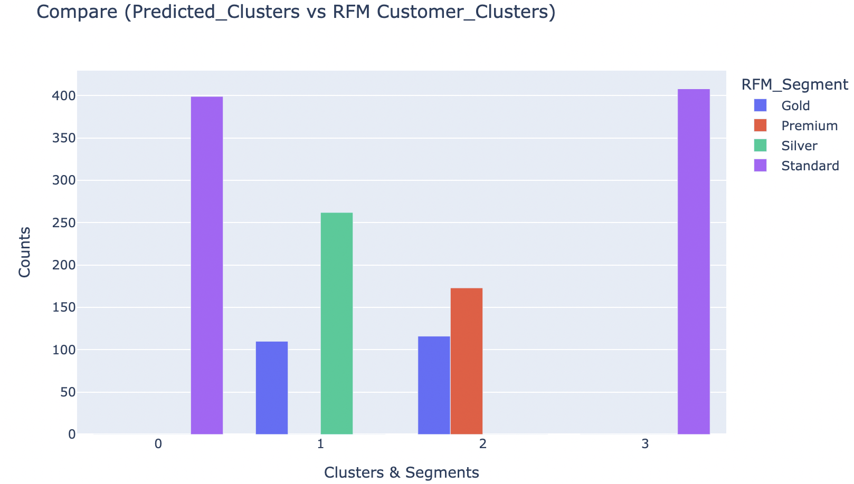
K-Means Clustering
The unsupervised machine learning model not only validates but enhances traditional RFM segmentation by providing key insights: it effectively identifies low-value 'Standard Customers' in two distinct clusters, suggesting different types of low-value customers; it establishes a clear hierarchy between high-value and mid-value customers, allowing marketing to treat those in Cluster 2 as VIPs and nurture those in Cluster 1; and it offers a nuanced view of 'Gold Customers' by distinguishing between those who behave like 'Silver' and those who resemble 'Premium' customers, enabling tailored marketing strategies for each group.

Slide 33

Revenue Category Prediction

Slide 34
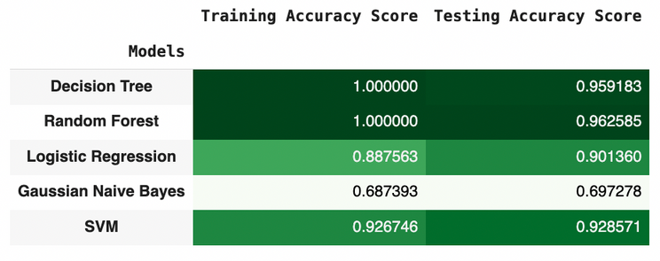
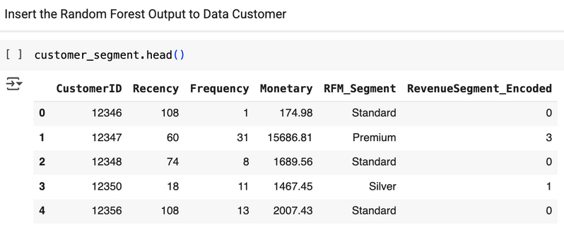
Revenue Category Prediction
Predict the Revenue Category Prediction using RFM-based segmentation (category bins: Standard, Silver, Gold, and Premium) is very common, logical, and powerful workflow in data science and marketing analytics.
Why? Because machine learning model can accurately predict these segments (as shown in the model comparison table with ~96% accuracy for Random Forest) proves that your RFM rules are capturing real, meaningful differences in customer behavior.
Prediction accuracy of the training data and test data on the Random Forest model has a value that is not much different, it can be said that the model is very good, that is, there is no underfitting or overfitting. So the Random Forest model was chosen as the best model to predict Revenue Category.

Slide 35
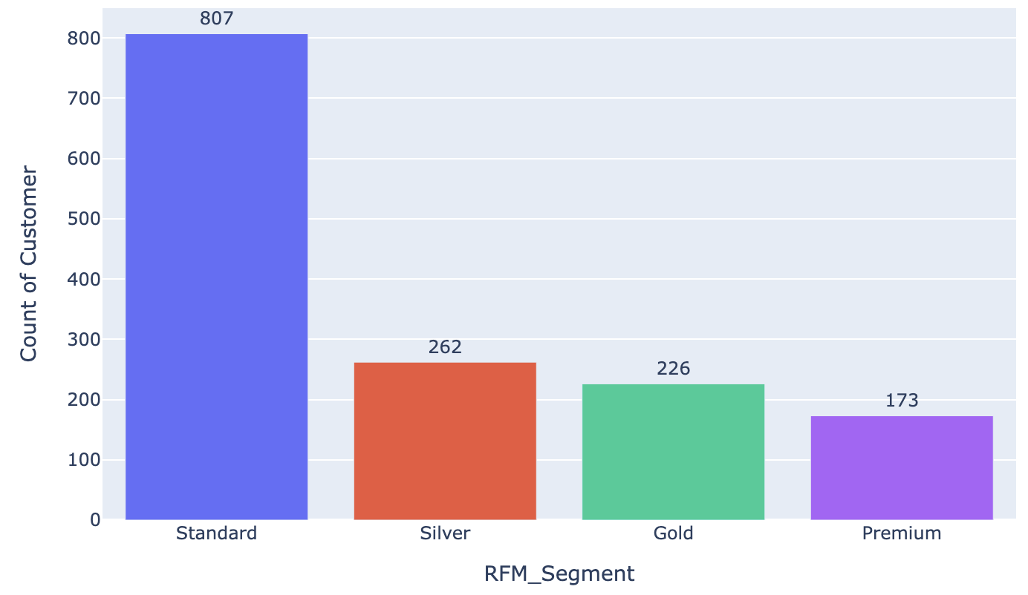
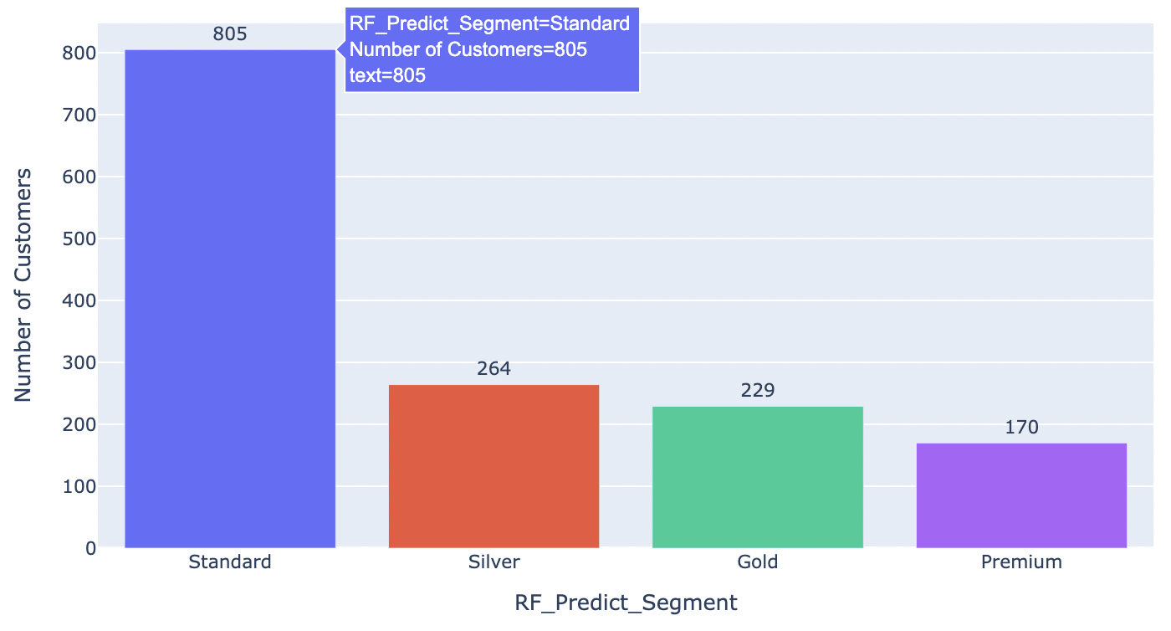
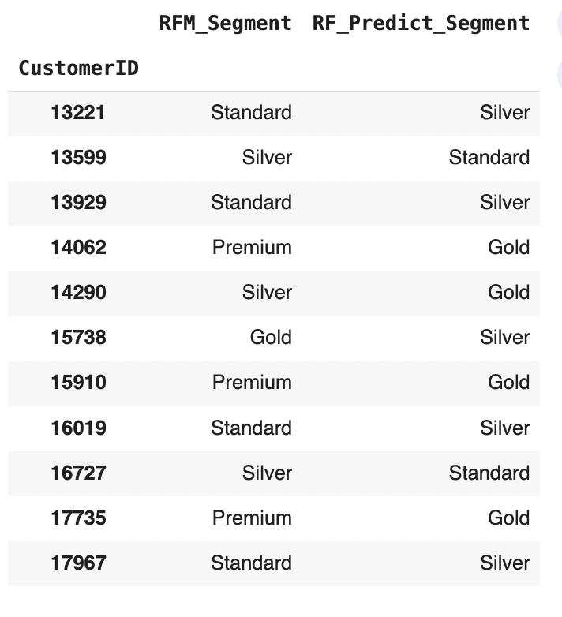
Revenue Category Prediction
Customer Predicted by RFM Analysis
Customer Predicted by Random Forest Machine Learning
The Model's Predictions are Extremely Close to Reality. The overall shape and proportions of the two charts are nearly identical. it can be found that there is a transition from RFM segment to the Random Forest Prediction owned by 11 customers.
This visual evidence strongly supports the high accuracy score reported earlier. The model is not just accurate overall, but it is also correctly capturing the size and distribution of each distinct customer segment.
And the Small Discrepancies Are Expected and Informative: No model is perfect, and these minor differences represent the ~4% error rate. The model might be misclassifying a few 'Standard' customers as 'Silver' or a few 'Premium' customers as 'Gold'. This is often due to "edge cases"—customers who are right on the borderline between two segments. For example, a customer might have just missed the spending threshold to be considered 'Premium', so the model, looking at other factors, predicts them as 'Gold'.

Slide 36


Cross Selling: Which Product Are
Selling Together ?

Slide 37
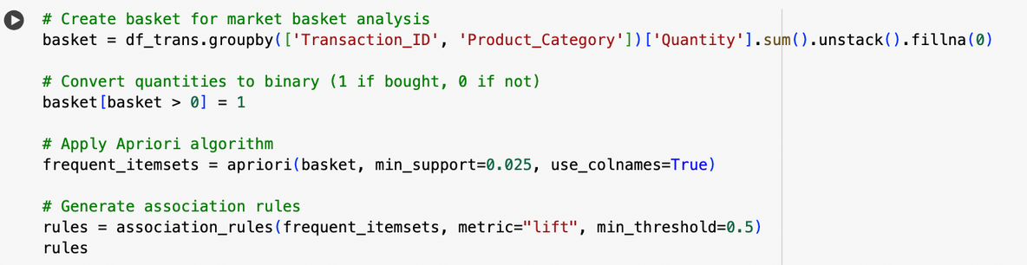
Cross Selling: Which Product Are Selling Together ?
The Apriori algorithm is a popular algorithm for association rule mining in data mining and is commonly used in market basket analysis. Market basket analysis involves discovering associations between products or items based on customers' purchase patterns
Support: The support of an itemset is the proportion of transactions in the dataset that contain the itemset. It helps identify the most frequent itemsets.
Confidence: Confidence measures the likelihood that an association rule is true. It is the ratio of the support of the combined itemset to the support of the antecedent (left-hand side) itemset.
Lift: Lift is a measure of how much more likely items are purchased together compared to what would be expected based on their individual support. A lift greater than 1 indicates a positive correlation between items.

Slide 38
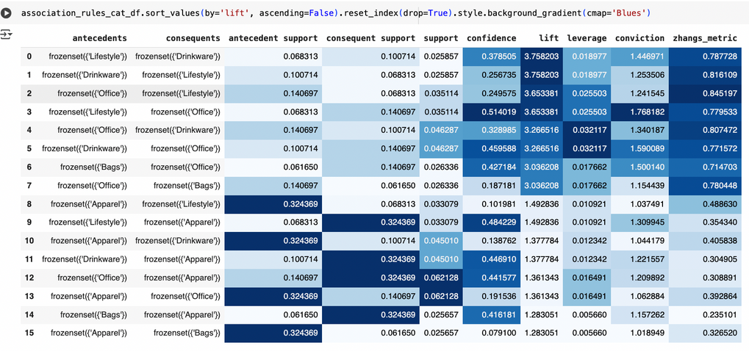


Cross Selling: Which Product Are Selling Together ?
When viewed from Confidence, Office and Lifestyle Category Products have the highest Confidence value so they can be recommended as Bundle Products. When viewed from Lift, Lifestyle and Drinkware Category Products have the highest Lift value so they can be recommended as Bundle Products.
When viewed from Support, Apparel and Office Category Products can be recommended as Bundle Products because they have the highest Lift value. Which one can be recommended as a Bundle Product? it all depends on what value is the focus (whether from the Lift, Support or Confidence value).
In addition, it can be seen from how the Sales effectiveness of each recommended Product Category and the right moment to launch the Bundle Product.

Slide 39
Next Purchase Days Prediction

Slide 40

Next Purchase Days Prediction
This analysis categorizes purchase days into four distinct groups: 0-30 Days, 30-60 Days, 60-90 Days, and 90+ Days, utilizing the Random Forest Classifier Algorithm.
Why choose this method? The Random Forest model demonstrates impressive prediction accuracy, with minimal variance between training and test data. This consistency indicates that the model is well-balanced, exhibiting neither underfitting nor overfitting. Consequently, the Random Forest model has been selected as the optimal choice for predicting revenue categories.

Slide 41
COHORT ANALYSIS

Slide 42

Cohort Analysis
This cohort analysis table tracks customer retention over time. Each row represents a cohort of customers who made their first purchase in a specific month (CohortMonth). The columns (CohortIndex) show the percentage of those customers who returned to make another purchase in the subsequent months.

Slide 43

Cohort Analysis
Initial Retention Varies Significantly: The retention rate in the second month (CohortIndex 2), which is a critical indicator of initial customer satisfaction, shows wide variation. The June cohort had the strongest start, with 14.6% of customers returning in the following month. In contrast, the January cohort had the weakest start with only a 6.0% retention rate.
Unusual Spikes in Long-Term Retention: While customer retention typically declines over time, some of the early cohorts show surprising re-engagement peaks in later months. For example, the February cohort saw its retention jump to 22.9% in its sixth month, the highest medium-to-long-term retention rate in the dataset. Similarly, the January cohort experienced a spike to 21.9% in its eighth month. This unusual behavior could suggest successful re-engagement marketing campaigns targeting these older customer groups.
Strong Early Performance by the March Cohort: The cohort of customers acquired in March 2019 demonstrated very strong early engagement. It achieved a 19.8% retention rate in its third month (CohortIndex 3), the highest of any cohort at that stage, indicating a highly positive initial experience for this group.
Declining Retention in Later Cohorts: The cohorts from later in the year appear to be less sticky. The September cohort, shows a rapid decline, dropping from 7.7% in the second month to just 2.6% by the fourth month. This trend could point to a change in acquisition channels, customer quality, or market conditions towards the end of the year.

Slide 44
Customer Livetime Value
(CLV) Analysis

Slide 45

CLV Analysis
Based on the table above, it is recommended to implement targeted campaigns—such as discounts and cash backs—for customers who joined in January and February. This cohort has generated a significantly higher amount of revenue over time compared to other months. Additionally, engaging these customers may further extend their average lifespan, resulting in increased revenue potential.

Slide 46

THANK YOU
I appreciate your time and feedback. Please feel free to share any comments or questions you may have to help me improve further.
Looking forward to hearing from you!

